Slide 1
T1S Autoconfiguration Tooling
17. Oktober 2024
Martin Ruppert

Slide 2
Motivation
To give us ESE a learning curve in
T1S Technology
C and Pyhton Coding
Project Working
git and Github
MDB Core
Soft- and Hardware Testing
Wireshark
This project is not about creating a Software Engineering Company within the Microchip Sales Organization. It is about to learn the processes, structures and vocabulary that our customer are dealing with
All items in the list above could be used in total different customer support processes
And maybe another result could be a proof of concept for customers in the industrial area for an T1S autoconfiguration scenario

Slide 3
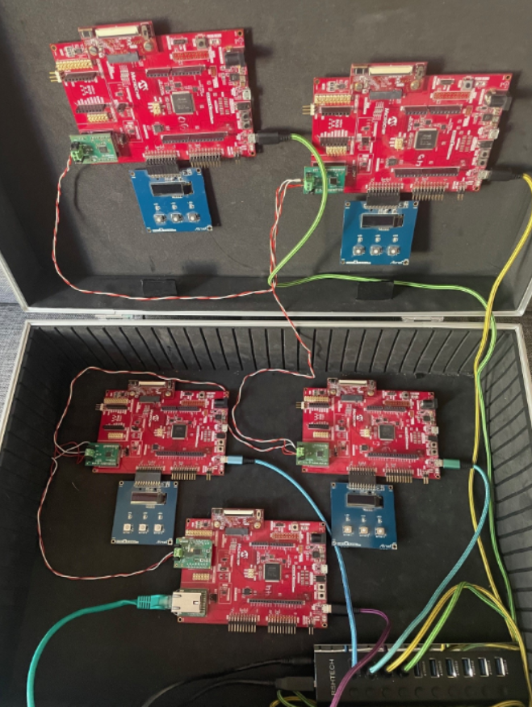
Setup
One Firmware for all 4 boards
Communication between boards should be visible in the OLED1 Extension
Demo should be controllable with only the OLED1 Extension
More complex operations can be done via a terminal
Hardware
SAME54 Curiosity DM320210
EVB-LAN8670-RMII EV06P20A
OLED1 ATOLED1-XPRO
A fifth board is acting as a T1S to 100BaseT Bridge for analyzing the T1S Traffic with Wireshark on a PC
SAME54 Curiosity DM320210
LAN8651 MIKROE-5543
LAN8720A PHY DAUGHTER BOARD AC320004-3

Slide 4
Github Project
The whole project inclusive all Pyhton Codes and the Presentation is hosted on github at
https://github.com/zabooh/T1S_Autoconf.git
It is a Fork of
https://github.com/Microchip-MPLAB-Harmony/net_10base_t1s.git
from version v1.3.0
The target is to make it official available at https://github.com/MicrochipTech

Slide 5
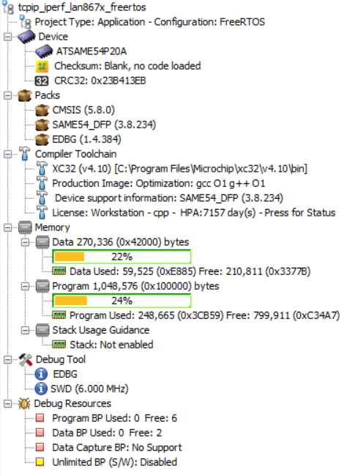
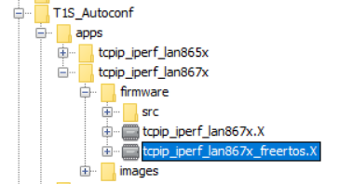
MPLABX Project
git clone https://github.com/zabooh/T1S_Autoconf.git

Slide 6
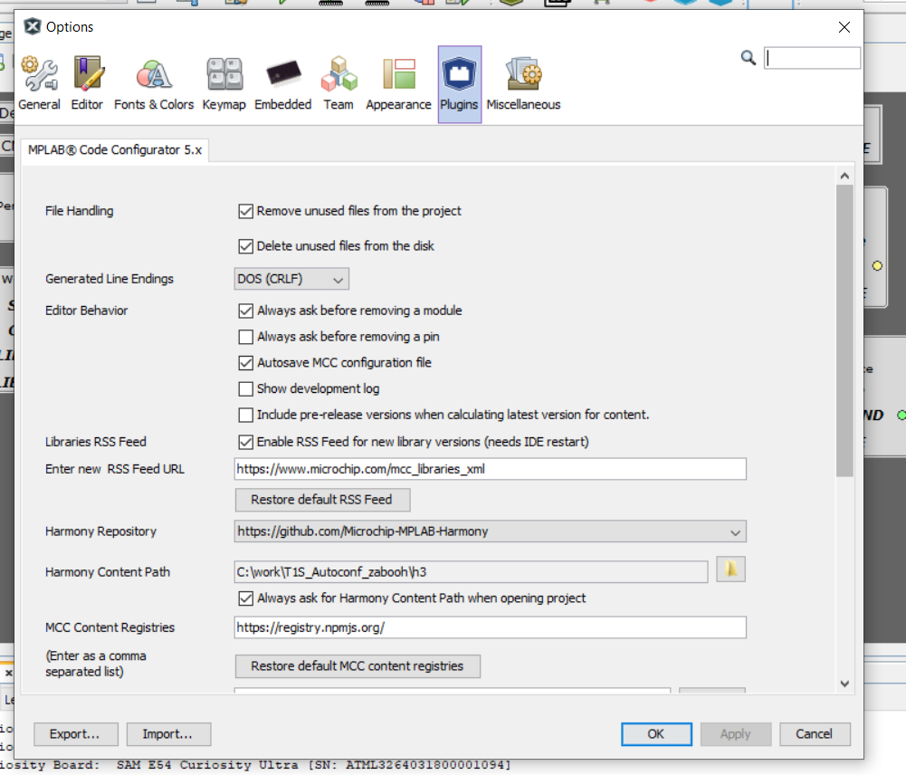
Set Path to the Harmony Framework Installation

Slide 7

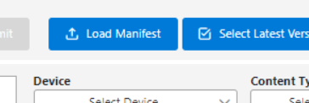
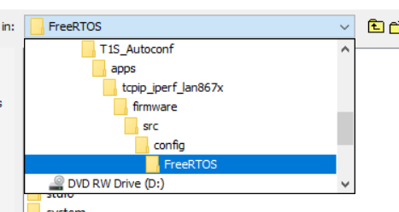
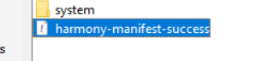
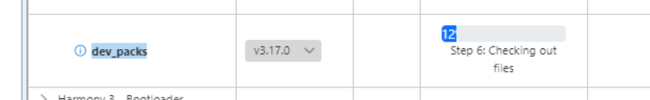
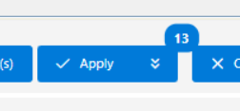
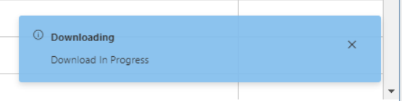
Content Manager for Framework Repositories
This takes „some“ time

Slide 8

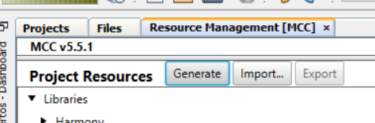
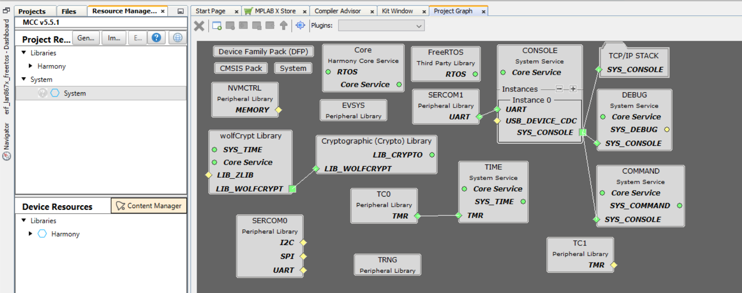
MCC to re-generate Source Code or modifying

Slide 9
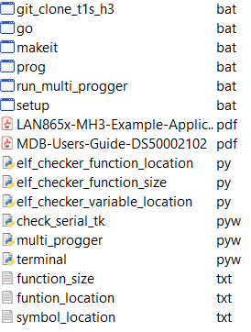
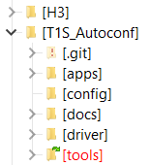
Programming 4 Boards at the same time
If another MPLABX Version should be used than v6.15, this must be changed in the script
The Tool „multi_progger.pyw“ is a Python Tkinter GUI that controlls 4 instances of the MDB Core simultary.
This allows to keep the connection to four MDB‘s instances and programming four controller at the same time.

Slide 10
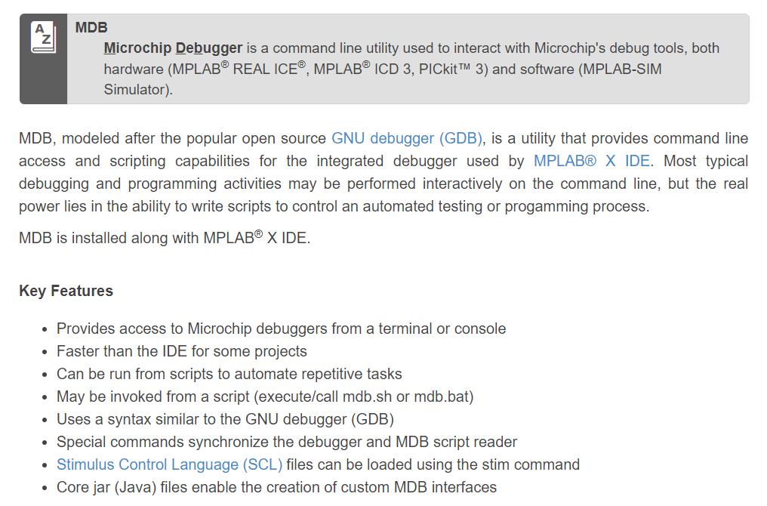
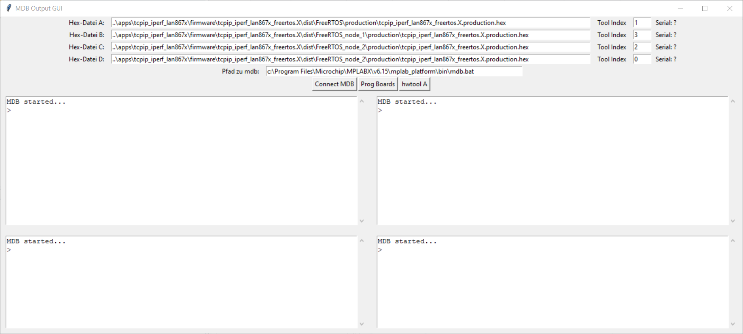
Python GUI for parallel Programming with MDB
The Pyhton Script starts MDB.bat as a Sub-Process and controlls the input and output. This allows a „remote control“ of the MDB.bat
More Information about the MDB and how to use it at: https://microchipdeveloper.com/mplabx:mdb

Slide 11
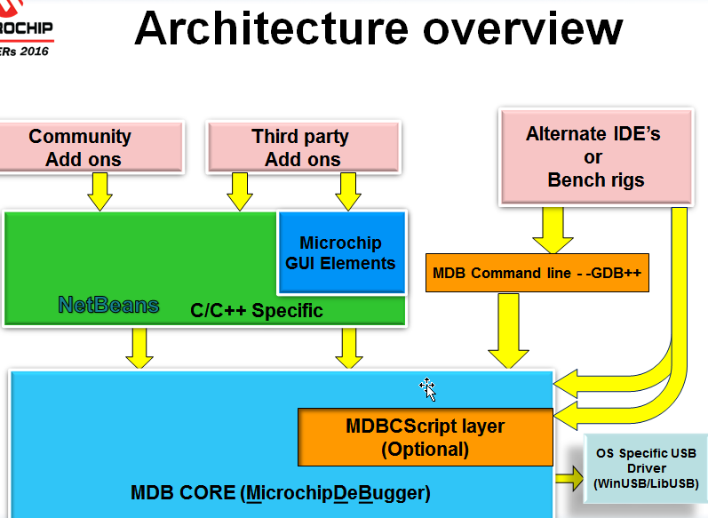
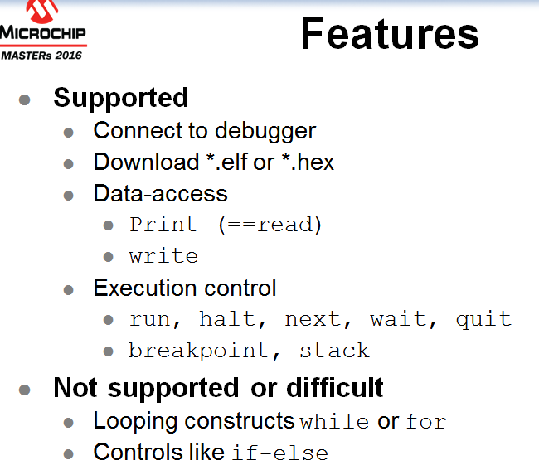
MDBCore / background
mdb.bat
MPLAX IDE
mdb.bat
mdbcs
Pre- & postprocess data/memory

Slide 12
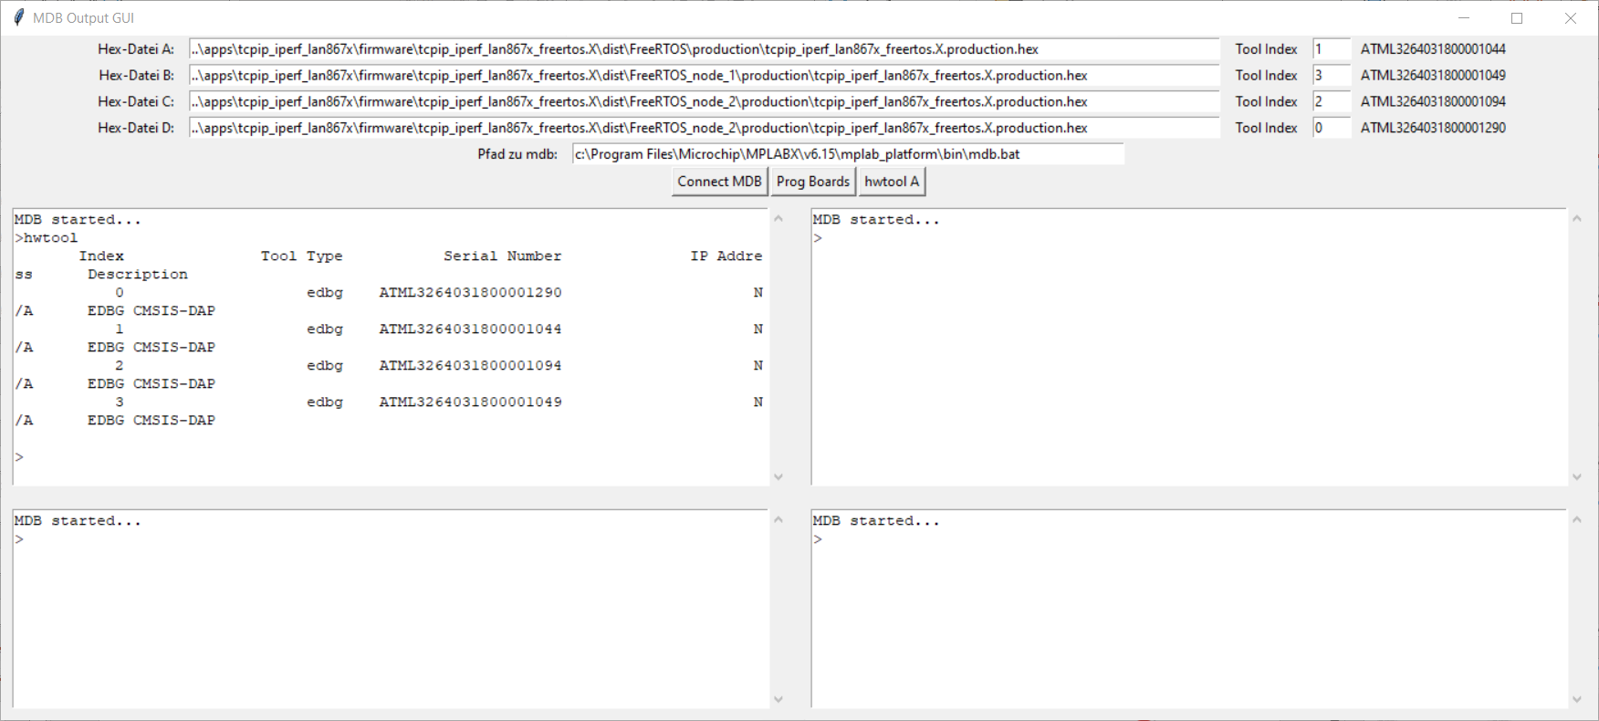
Python GUI for parallel Programming with MDB
„hwtool“ is a MDB command that lists all available debuggers and assigns them an index number. This index number is used to select the debugger
By changing the index number, a debugger can be specifically assigned to a window

Slide 13
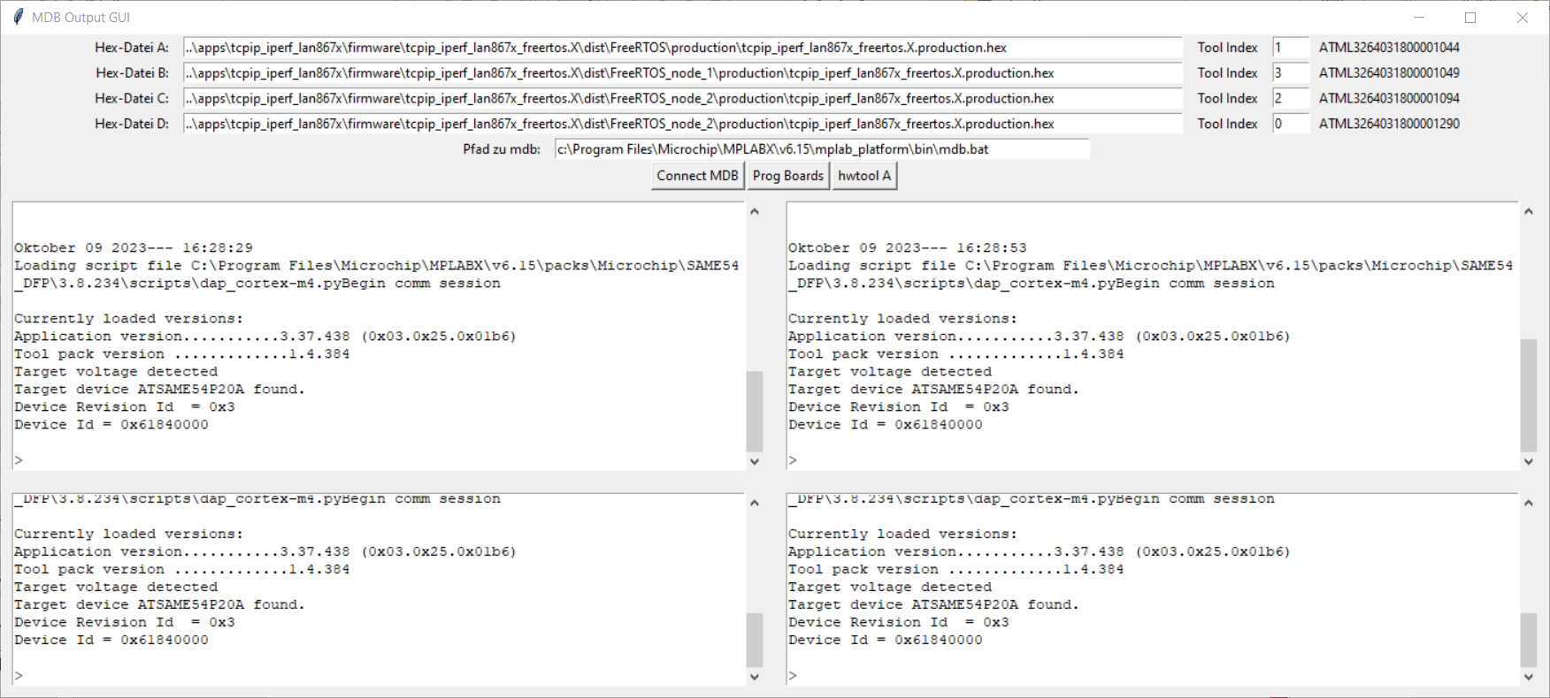
Python GUI for parallel Programming with MDB
With clicking on „Connect MDB“, all setup is done for EDGB, Speed 6Mbit, SWD Interface and selecting the debuggers. This takes some time until it‘s connected
Keep in mind that every mdb.bat process do need about 2 Gbyte of RAM. All four instancess are around 8 Gbyte of RAM

Slide 14
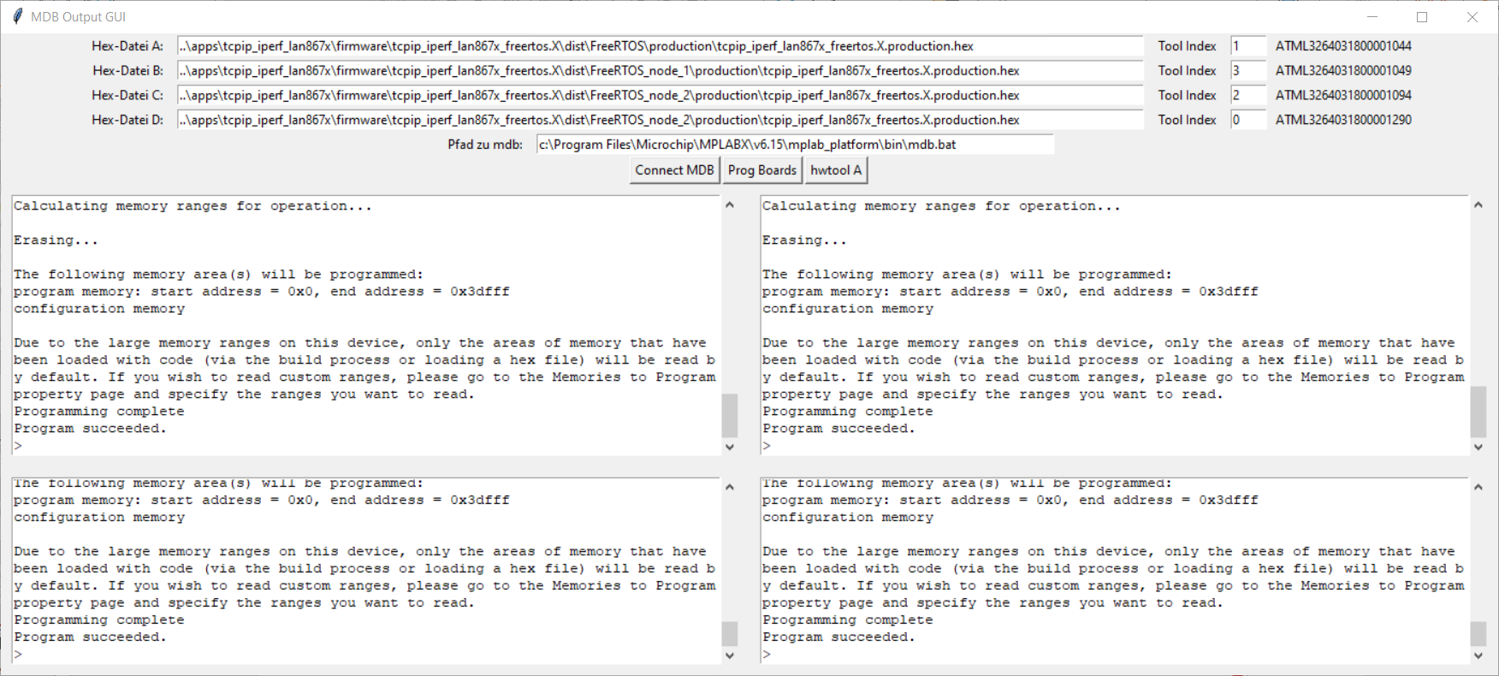
Python GUI for parallel Programming with MDB
“Prog Boards” programs all Hex files in parallel. The connection to the debugger is maintained so it is not necessary to re-establish the connection again. This allows the programming process to start more quickly.

Slide 15
Python GUI for testing 4 Boards in parallel
„terminal.pyw“ is the Terminal program that talks with 4 Boards at the same time.
The idea came to me when I was once again completely annoyed by having to arrange TerraTerm four times on my desktop and assigning them to the corresponding COM ports

Slide 16
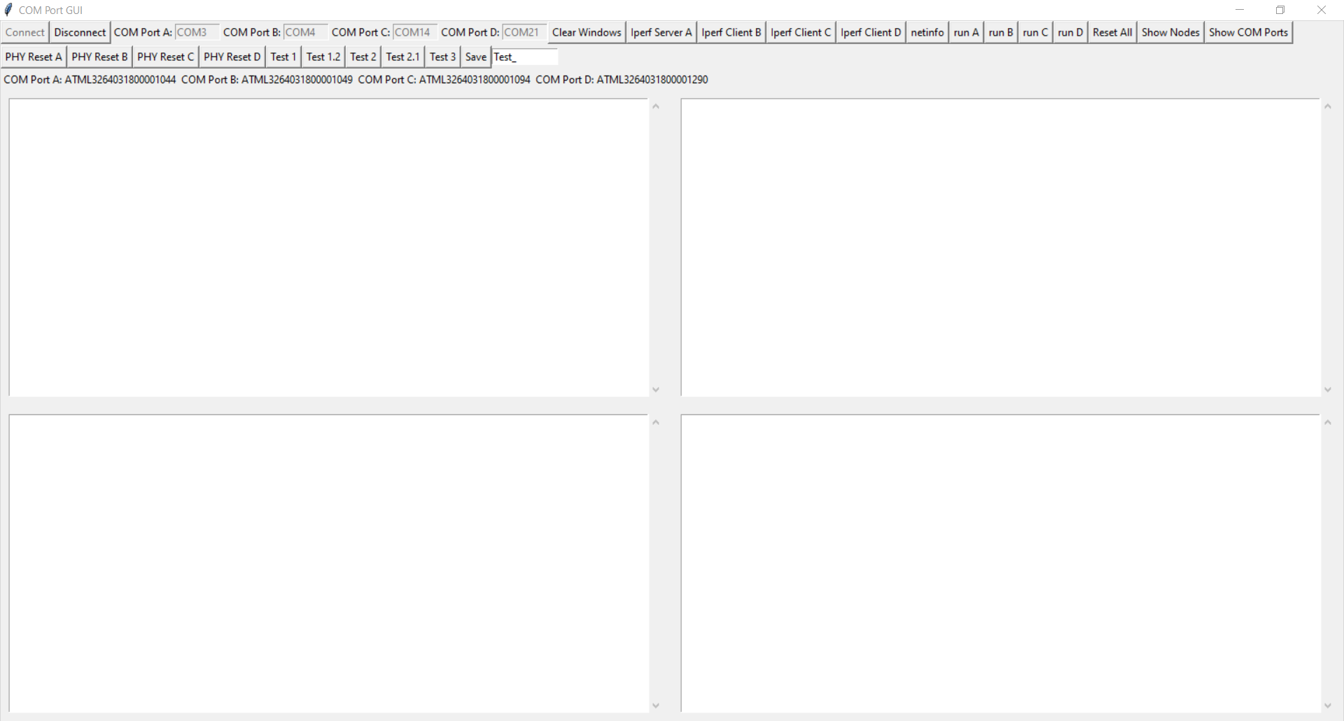
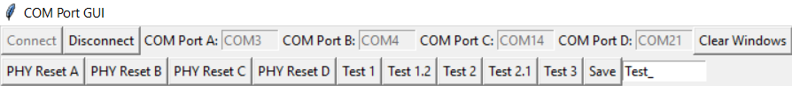
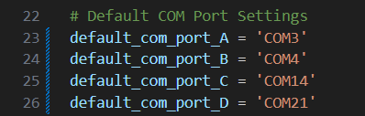
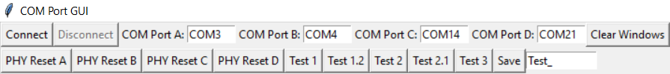
Python GUI for testing 4 Boards in parallel
If a COM Port entry is left free, this COM port is not used, so that this tool can be used with less than 4 boards
This tool is basically a 4-way Comport Terminal.
There are 4 default COM ports in the upper left, which must be changed to the ones on your machine.
If a COM Port entry is left free, this COM port is not used, so that this tool can be used with less than 4 boards
The default ports can be set in the source code
If you click on “Connect” while all comports are available, then the COM Port Entries go to gray.
If at least one COM Port isn’t available, nothing happens.

Slide 17

Python Modules Dependencies „terminal.pyw“
pip install pyserial
https://pythonhosted.org/pyserial/index.html
This module encapsulates the access for the serial port. It provides backends for Python running on Windows, OSX, Linux, BSD (possibly any POSIX compliant system) and IronPython. The module named “serial” automatically selects the appropriate backend.

Slide 18

Python Modules Dependencies „terminal.pyw“
pip install matplotlib
https://matplotlib.org/
Matplotlib is a comprehensive library for creating static, animated, and interactive visualizations in Python. Matplotlib makes easy things easy and hard things possible.

Slide 19
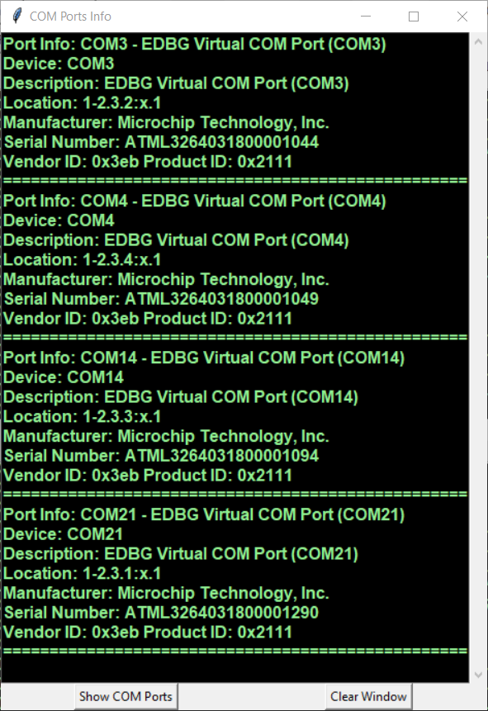
Python GUI for testing 4 Boards in parallel
A
B
C
D

Slide 20
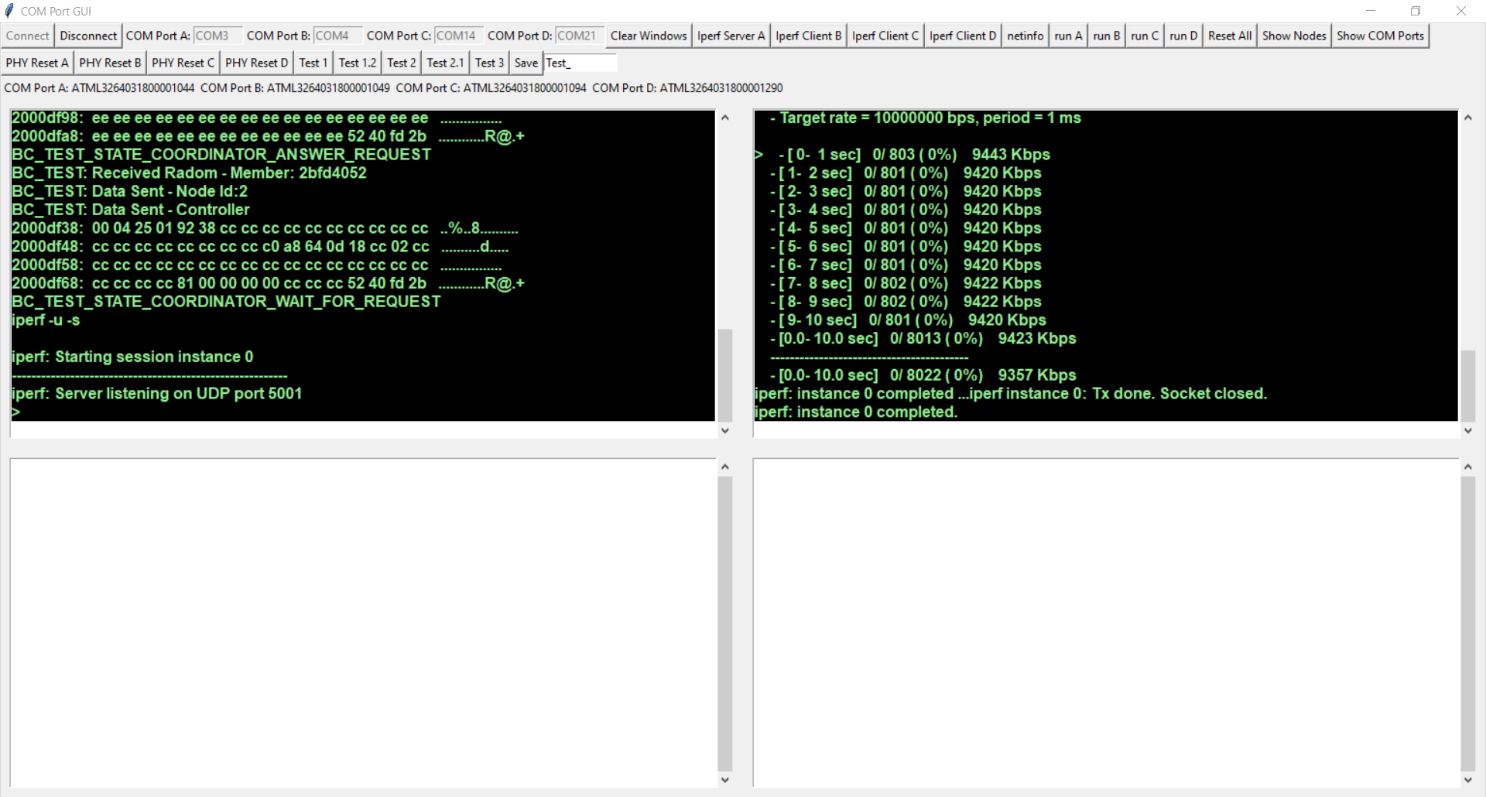
iperf with two boards
A Bandwidth of approx. 9.4 Mbit/sec UDP traffic is achieved between two boards

Slide 21
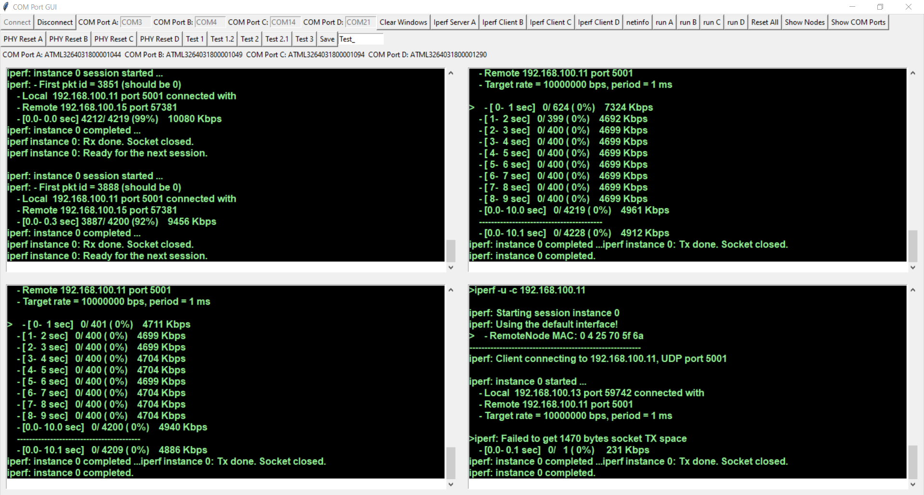
3 iperf client’s at the same time
A Bandwidth of approx. 3.1 Mbits/sec UDP Traffic is achieved when 3 iperf clients are running simultaneously

Slide 22
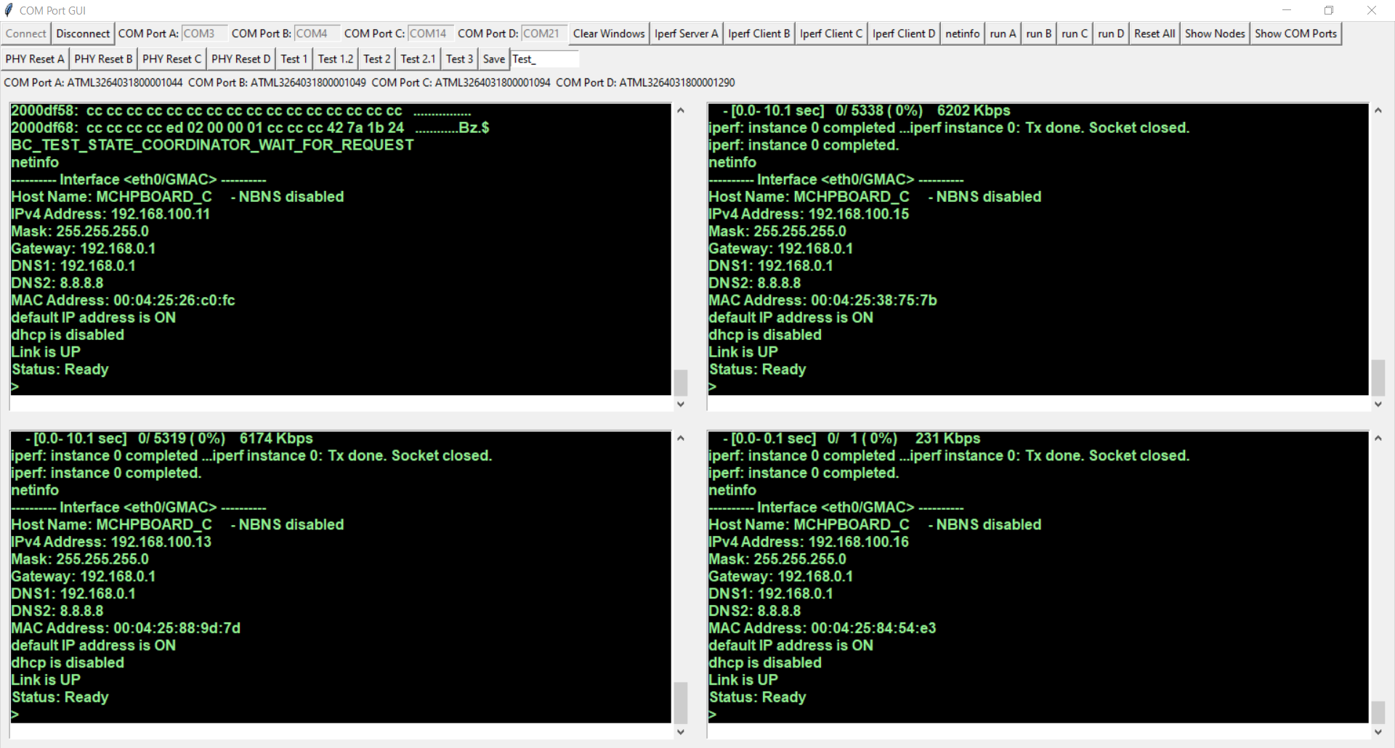
Sending the command “netinfo” to all boards
Pre defined commands can be send to one or more boards at the same time when a button is clicked.

Slide 23
T1S to 100BaseT Bridge

Slide 24
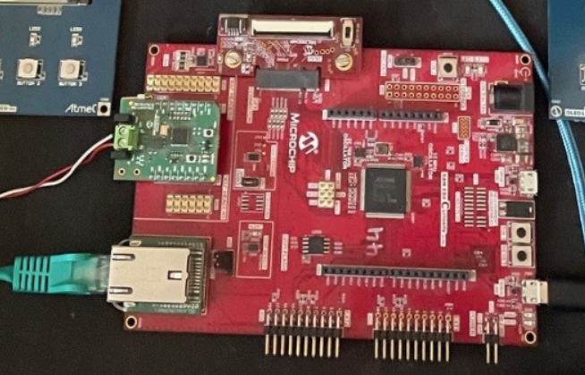
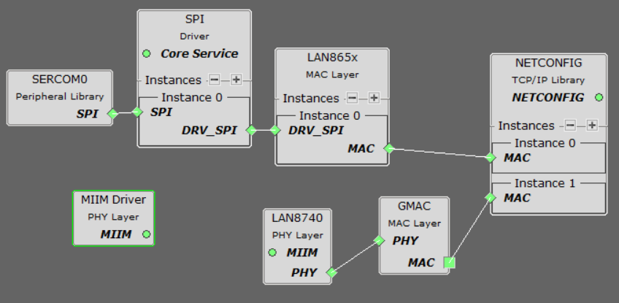
Bridging
https://github.com/zabooh/t1s_100baset_bridge.git

Slide 25
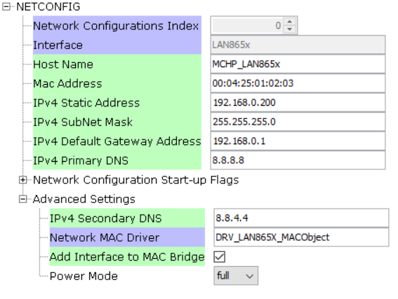
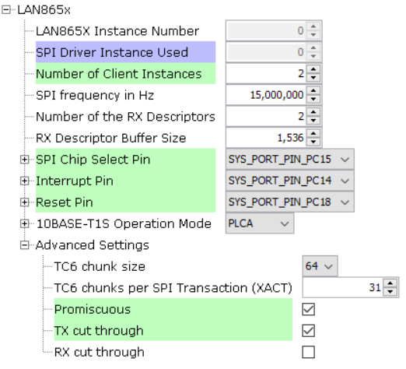
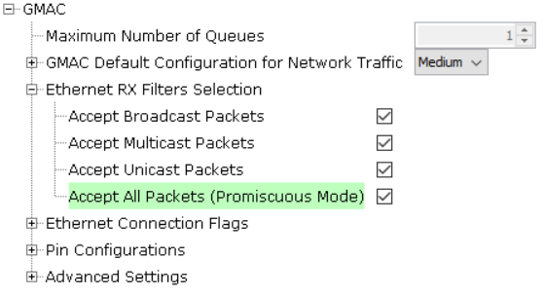

Slide 26
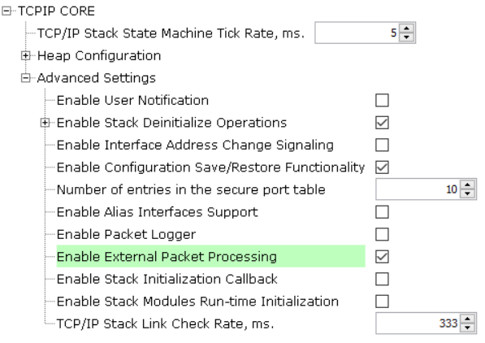
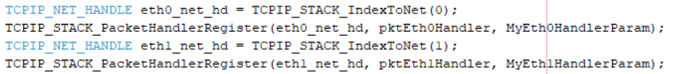
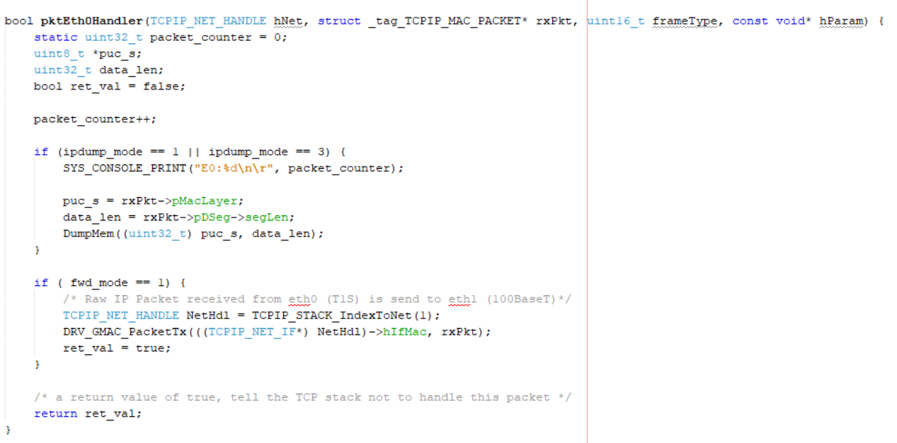
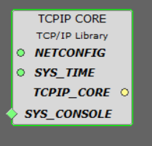

Slide 27
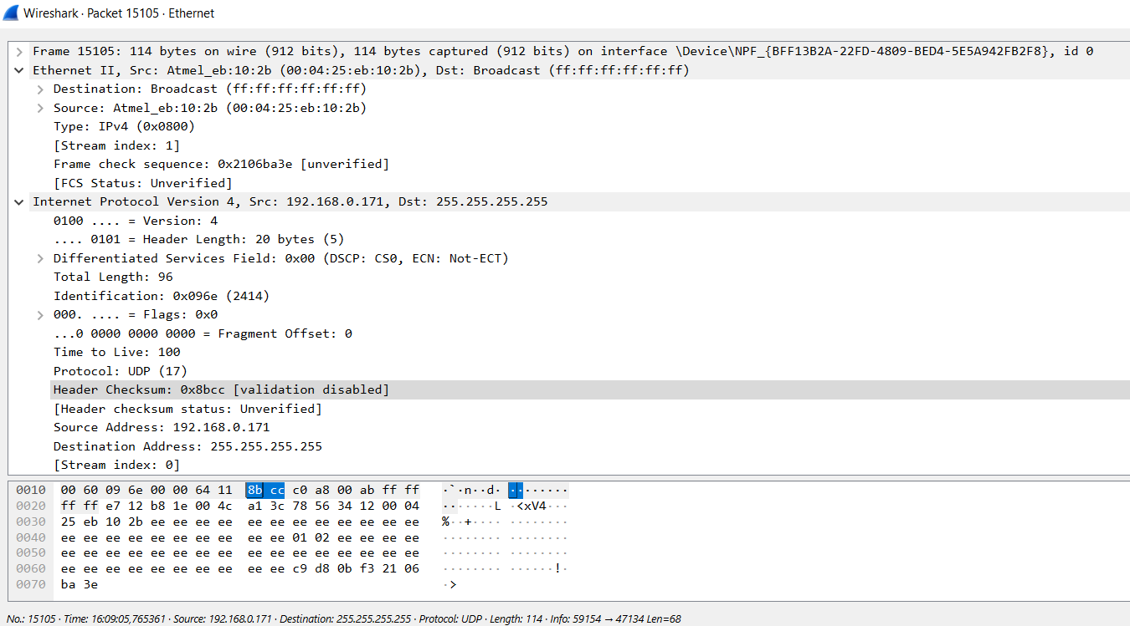
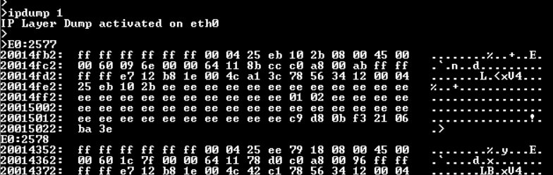

Slide 28
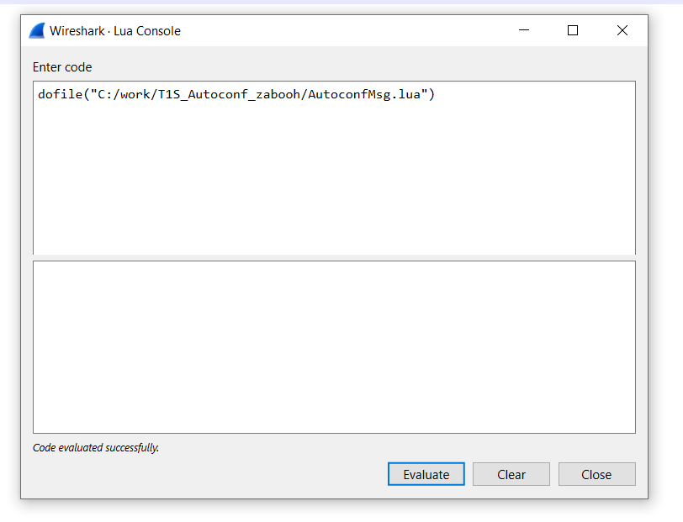

Slide 29
-------

Slide 31
Wireshark

Slide 32
How to Analyze the Traffic
Rest of
the Universe
Managed Switch
1
2
3
4
5
6
7
8
Personal Computer

Slide 33
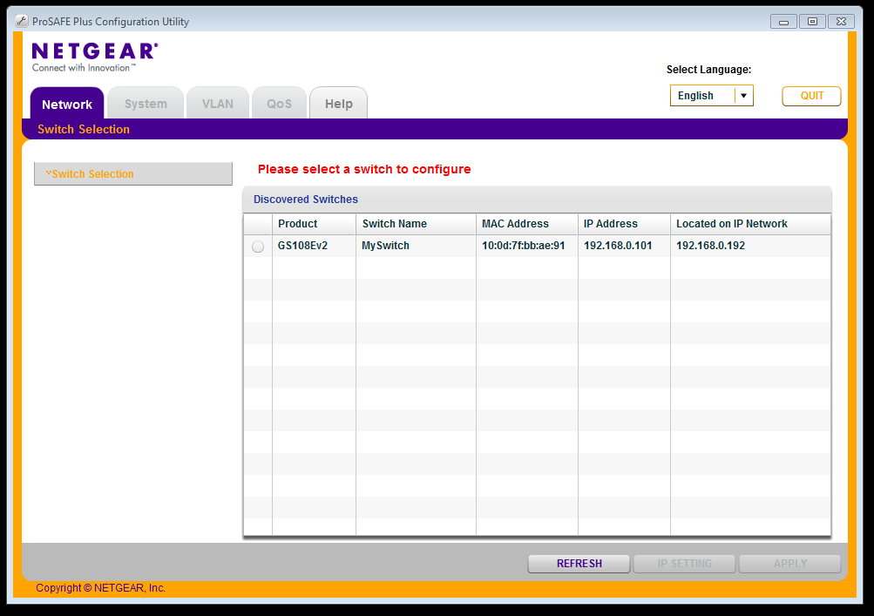
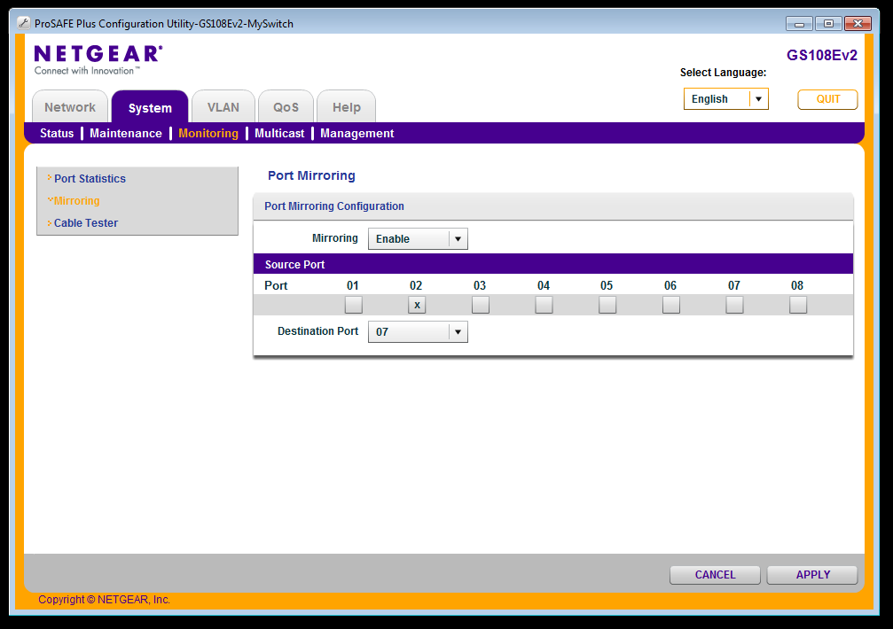
Configuration Software for Managed Switch
Microchip confidential – tentative

Slide 34

How to Analyze the Traffic
Rest of
the Universe
Managed Switch
All traffic on Port 2
is „mirrowed“ to Port 7
1
2
3
4
5
6
7
8
Personal Computer

Slide 35
-------

Slide 36
Software

Slide 37
OLED1 Display Support
printf for OLED Display

Slide 38
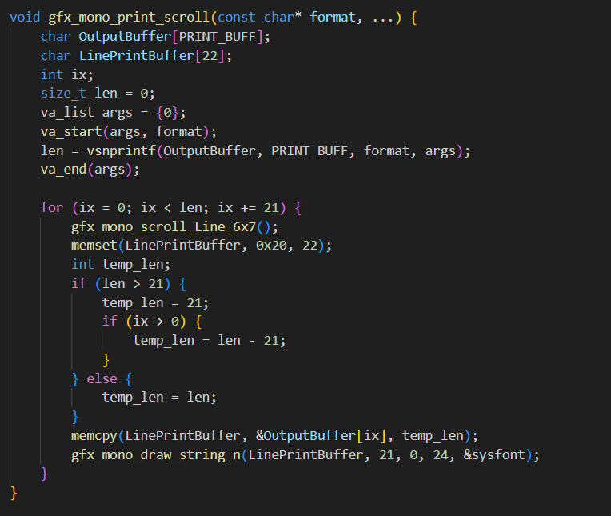
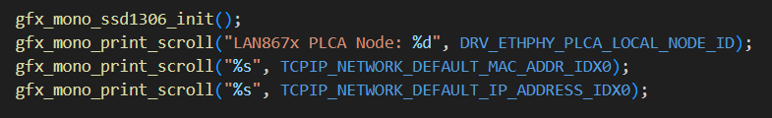

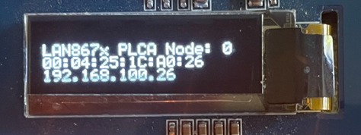
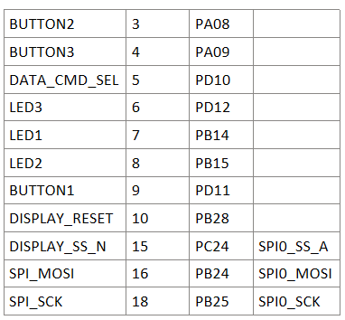
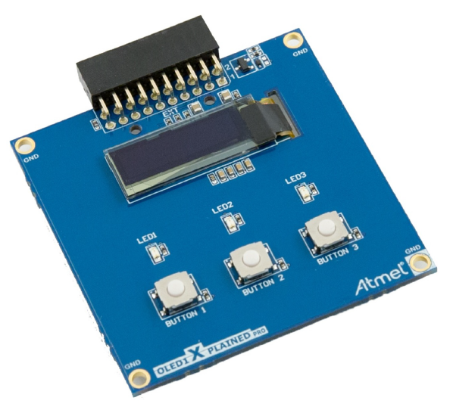

Slide 39
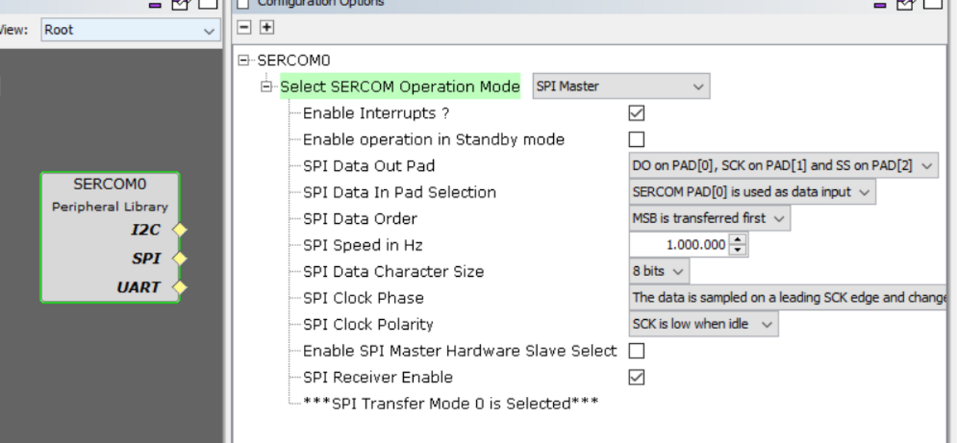
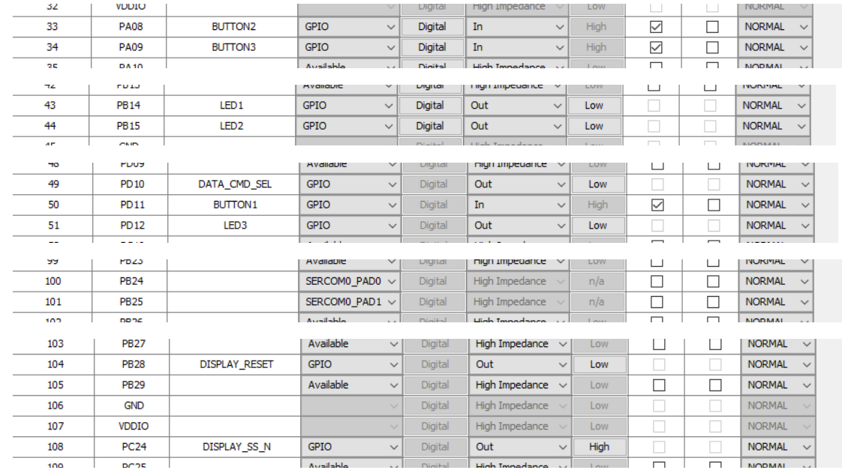


gfx_mono

Slide 40
Exception Handler
How to access the Stack Pointer in C

Slide 41




In case of an Exception this register are put onto the stack automatically:
R0-R3
R12
LR (Link Register)
PC (Program Counter)
PSR (Program Status Register)

Slide 42
R0-R3 (Registers 0 to 3):
General registers used to store data and intermediate results.
R12 (Register 12):
Also a general register used to store data and intermediate results.
LR (Link Register):
The link register stores the return address of the current program so that normal program flow can be restored after the execution of a subprogram or an exception.
PC (Program Counter):
The program counter is a register that contains the address of the next instruction to be executed in the program code. When an exception occurs, the PC is set to the address of the exception handler.
PSR (Program Status Register):
The Program Status Register contains status information about the status of the processor. This includes flags for the status bits (such as Z, N, C, V), the execution mode (thread or handler mode), the state of the interrupt (enabled or disabled), and other status information.

Slide 43





Adding a „Bus Fault Exception Test“ command

Slide 44



readelf –s x.elf
Creates Disassembly Listing File
objdump –S x.elf
Create Symbol List

Slide 45
Firmware State Machine
And how you can observe that

Slide 46


Node 0 sends a cyclic Beacon Frame (PLCA Mode)
In this case it is preconfigured for 8 Nodes. After the Beacon there are 8 Transmit Opportunities (Timeslots)
0
1
2
3
4
5
6
7
27,07us
29,2us
2,128us

Slide 47



Soft-Watchdog-Timeout

Slide 48


Slide 49
Dump Memory
Like in the good all times

Slide 50





Slide 51
Heap Managment
How do you find the culprit of a malloc fail?

Slide 52







Slide 53
Heap Managment
Show Heap Statistics

Slide 54





Slide 55
Virtual Command Receive
How send Commands by the Firmware

Slide 56





